Slide 1

MEALSTATION
Presented By : Brajendra Singh

Slide 2
Problem Statement:
In the existing system only we have to go to canteen and order the foods and we have to wait in queue for a long time to get the orders. This is the waste of time and energy.
The Lunch was of the limited time so we need a system so that we can enjoy it instead of waiting in the canteen queue.

Slide 3
Objective:
The aim of our project was to ease the current food delivery system in place.
We intended to automatize the process and make it easy for the canteen staff, students and faculty member.
We developed a systematic online food ordering system which can be used by the faculty members and students to order items quickly.
Also the order details are stored in the database.

Slide 4
Proposed Solution:
A website for students where detailed information of various foods items are available.
This website shows the prices and availability of the food items.
They can add different food items in their cart and then they can place the order.

Slide 5
Modules:
USER:
User can register and login with it’s credentials so that he does not have to provide their data every time.
ADMIN:
Admin interface is available for managing the category, items, order etc.
CART:
This module is used to manage the user item.
ITEM:
This module is used to manage the items by the admin.

Slide 6
Features
It provides the user friendly interface for non-technical people for adding data of food items.
User can place order if the item is available if the item is not available then user cannot place the order.
User can add the item to the card and can place the orders.
User can see their order though card.

Slide 7
Technologies Used:
HTML
CSS
BOOTSTRAP
PYTHON (DJANGO)
MYSQL

Slide 8
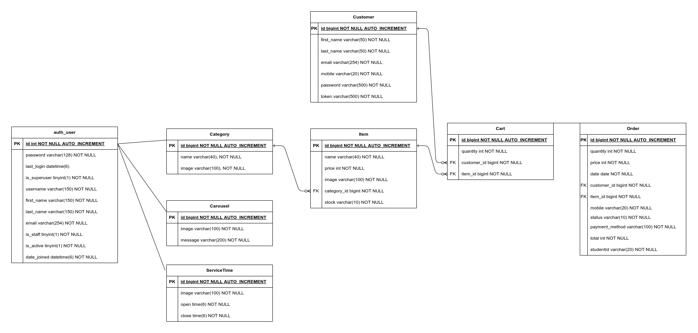
DATABASE SCHEMA DESIGN:

Slide 9
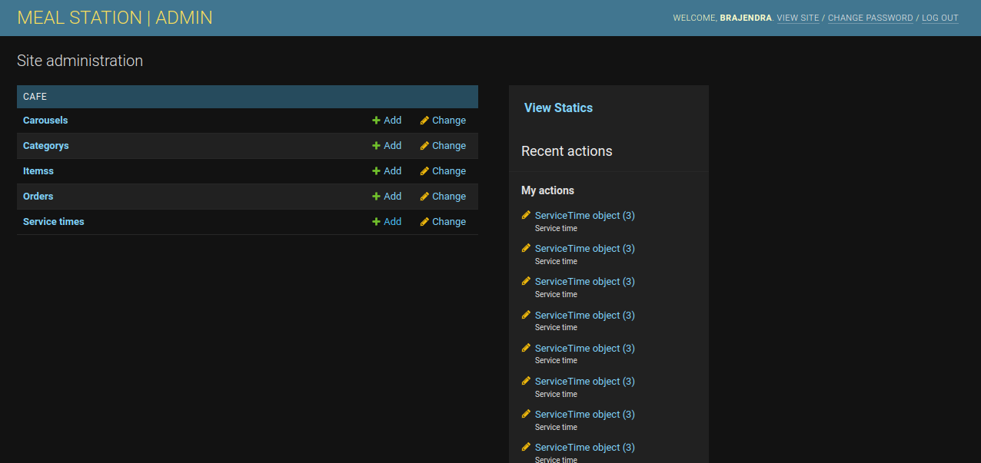
SCREENSHOTS:

Slide 10
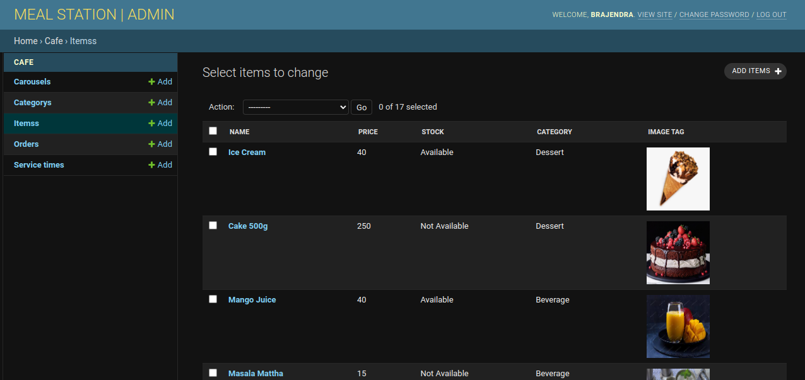
SCREENSHOTS:

Slide 11
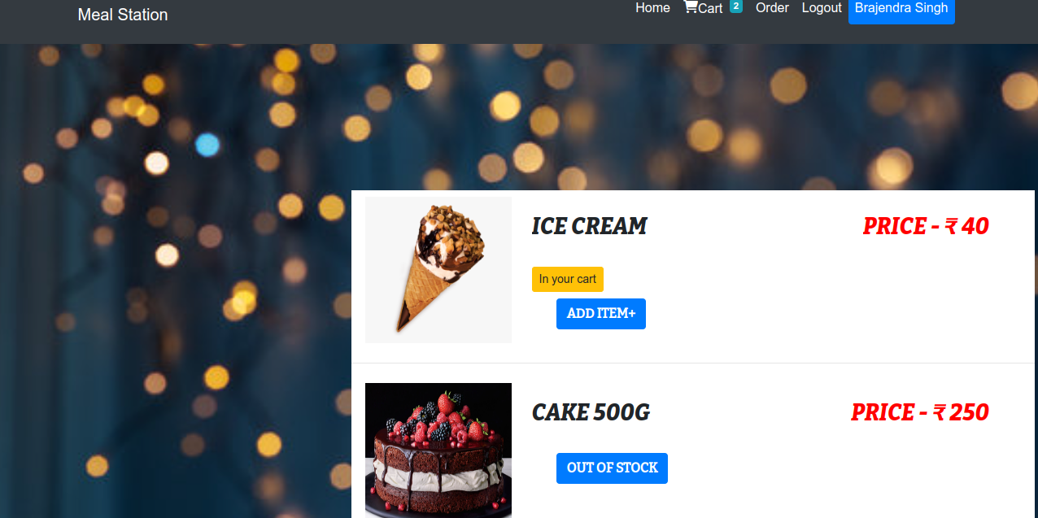
SCREENSHOTS:

Slide 12
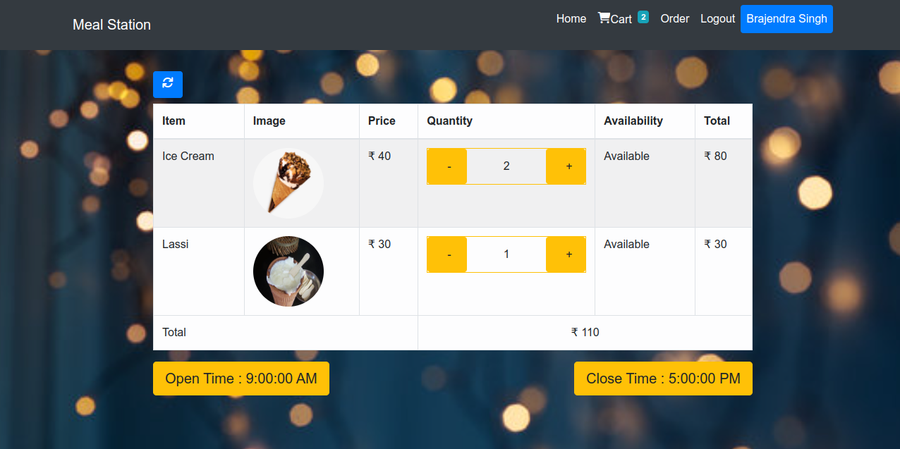
SCREENSHOTS:

Slide 13
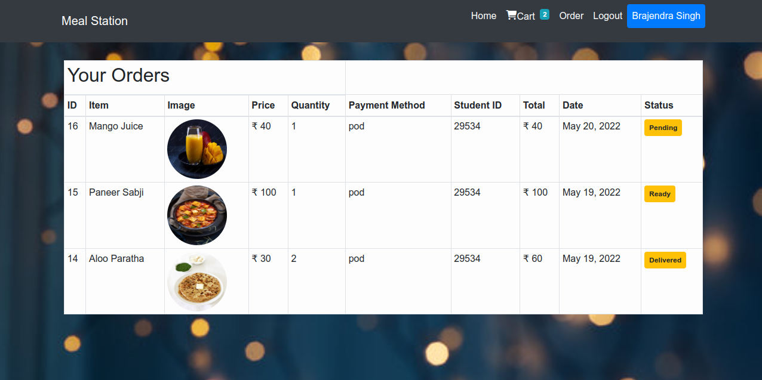
SCREENSHOTS:

Slide 14
THANK YOU!!

